Slide 1
Business Intelligence
9415-AY225-BSCS 3216

Slide 2
Course Objectives (Business Intelligenc)
Develop students’ understanding of Business Intelligence concepts, architectures, and processes for data-driven decision-making.
Equip students with skills in data collection, integration, transformation, and analysis using BI tools and techniques.
Enable students to design and implement dashboards, reports, and analytical models that support organizational strategies.
Promote critical thinking in interpreting data insights for managerial, operational, and strategic decision-making.
Foster ethical, responsible, and professional handling of data, ensuring data quality, security, and compliance with organizational and legal standards.

Slide 3
Lesson Learning Outcomes:
Week 1 – Introduction to Business Intelligence
Week 2 – BI Architecture and Components
Week 3 – Data Sources and Data Types
Week 4 – Data Warehousing Concepts
Week 5 – Dimensional Modeling
Week 6 – Prelim Assessment
Week 7 – ETL (Extract, Transform, Load) Processes
Week 8 – Data Quality and Data Cleaning

Slide 4
Lesson Learning Outcomes:
Week 9 – Descriptive Analytics
Week 10 – Data Visualization Principles
Week 11 – BI Tools and Dashboards
Week 12 – OLAP and Multidimensional Analysis
Week 13 – Predictive and Prescriptive Analytics (Overview)
Week 14 – BI for Decision Support
Week 15 – Ethics, Privacy, and Data Governance
Week 16 – BI Project Development

Slide 5
Lesson Learning Outcomes:
Week 17 – BI Project Presentation
Week 18 – Final Assessment and Synthesis

Slide 6
Subject expectations
You will learn more about a BI professional’s role in an organization
Discover how to create tools and processes that empower the decision-making process.
Create dynamic reports and dashboards that communicate near-real-time data trends.

Slide 7
Introduction to Business Intelligence
Week 1 – Introduction to BI
Week 2 – BI Architecture and Components
Appreciate the role of data-driven decision-making in modern enterprises.
Identify real-world BI applications across industries.
Explain the scope, evolution, and importance of Business Intelligence in organizations.
Value structured system design and integration.
Illustrate a basic BI system architecture.
Describe BI architectures, components, and workflows.

Slide 8
Definition
Howard Dresner (1989) - founder and CRO of Dresner Advisory Services
Dresner used the phrase to describe a set of concepts and methods to improve business decision-making by utilizing fact-based support systems. (Khan A. (2025) Business Intelligence and Data Analysis in the Age of AI, Mercury Learning and Information)

Slide 9

Howard Dresner
Dresner’s early definition laid the groundwork for the field of business intelligence, which has since evolved into a crucial component of modern business strategies, involving data analysis, reporting, and the use of technology to provide actionable insights for organizations.

Slide 10
Business Intelligence Overview
The primary objective of Business Intelligence (BI) is to empower organizations with actionable insights derived from their data, fostering informed decision-making and strategic planning. By systematically collecting, processing, and analyzing data, BI enables enterprises to gain a comprehensive understanding of their internal processes, market dynamics, and customer behavior.

Slide 11
Evolution
Beginning in the late twentieth century, BI emerged as a concept for improving decision-making processes by leveraging data-driven insights.
Initially focused on reporting and querying, BI evolved with the advent of data warehousing, extract, transform, load (ETL) processes, and multidimensional analysis.
In the 2000s, a shift toward more user-friendly interfaces and interactive dashboards occurred, making BI accessible to a broader audience.
The rise of big data and cloud computing in the following decade further propelled BI, enabling organizations to handle larger datasets and facilitate real-time analytics.
Today, BI incorporates advanced analytics, machine learning, and Artificial Intelligence, providing predictive and prescriptive capabilities for more proactive decision-making.
The evolution of BI reflects a continuous adaptation to technological advancements, expanding its capabilities and impact on organizational strategies.

Slide 12
How Business Intelligence (BI) Is used: Scenario: A Retail Company Improving Sales and Inventory Management
Data Collection - The company gathers data from multiple sources:
Point-of-sale (POS) systems (daily sales)
Online store transactions
Inventory records
Customer loyalty programs
Data Analysis - Using BI tools, the company analyzes:
Which products sell the most by location and season
Peak shopping days and hours
Customer buying patterns (e.g., repeat customers, popular product bundles)

Slide 13
How Business Intelligence (BI) Is used:
Dashboards and Reports - Managers view interactive dashboards that show:
Real-time sales performance
Low-stock and overstocked items
Monthly and weekly sales trends
Decision-Making - Based on BI insights:
The company restocks fast-selling items before they run out
Slow-moving products are discounted or discontinued
Promotions are targeted to specific customer groups

Slide 14
How Business Intelligence (BI) Is used:
Business Impact
Reduced inventory costs
Increased sales and customer satisfaction
Faster, data-driven decisions instead of guesswork

Slide 15
Role of data-driven decision-making in modern enterprises
Business Intelligence applications play an extremely important role in this process.
BI Application Categories
Operations Reporting - This serves as a foundational layer for organizations to understand and optimize their day-to-day activities. It uses online analytical processing and visualization.
Analytics - encompassing a range of techniques, including predictive analysis and statistical analysis.

Slide 16
Enter a growing field of BI Professionals
According to the Philippine Skills Framework Companies report the largest skills gap in data analytics, and the demand for data analytics skills is growing over 15 times faster than the demand for the average skill in the US. (PSF, 2025).
Every business process, in organizations of all types and sizes, generates huge volumes of data. This data may be stored in different locations and formats that are difficult to access and don’t provide useful insights.
To use that data to effectively inform business decisions, it needs to be retrieved, structured, interpreted, and reported in usable formats that enable stakeholders to understand and act.

Slide 17
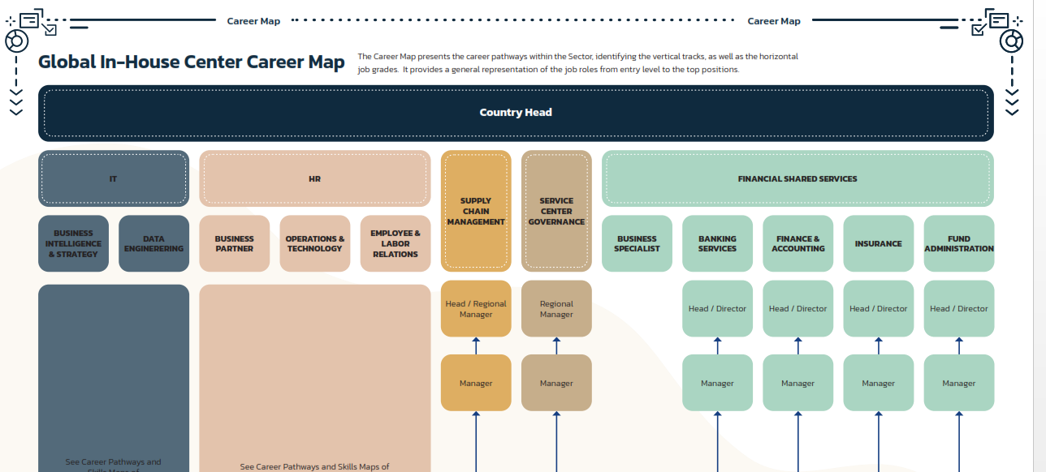
Global In-House Center Career Map

Slide 18
Business Intelligence Tools
Business intelligence tools form a diverse ecosystem, each category catering to distinct facets of data analysis and reporting.
Data Visualization Tools
Tableau by Salesforce
Power BI by Microsoft
Reporting Tools
SAP
Crystal Reports
IBM Cognos Reporting
Designed to create interactive visual representations facilitating a comprehensive understanding of complex datasets
Focus on structuring and presenting data in a clear and organized format, which is crucial for conveying critical business information effectively.

